Slide 1

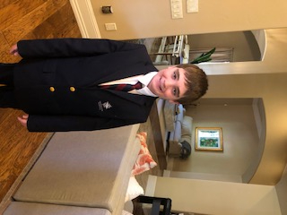
My Family History Project
By Loz McKenzie

Slide 2
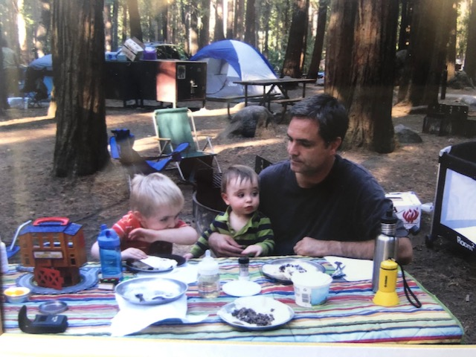
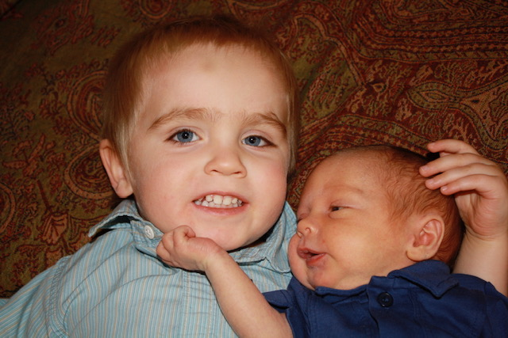
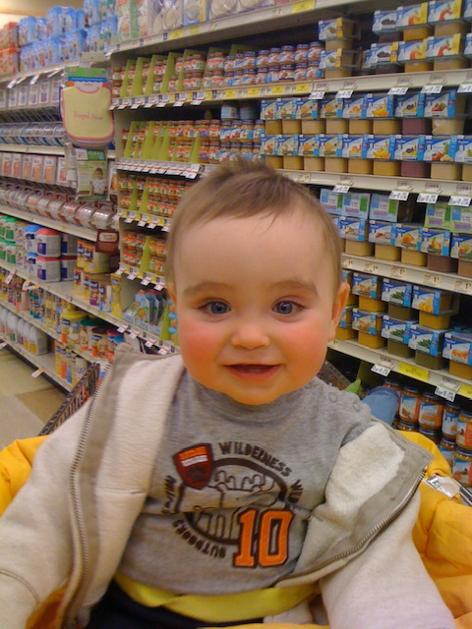
Timeline
2010 First tent camping trip to Yosemite National Park.
2009 I was born
2011 First
Time riding in
a shopping cart

Slide 3
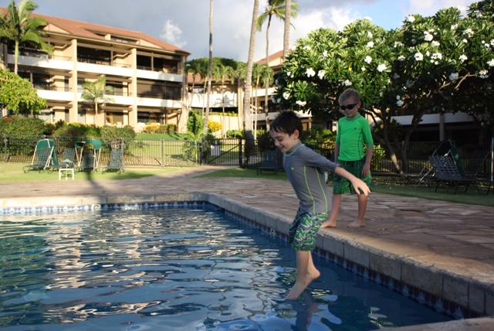
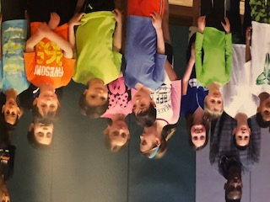
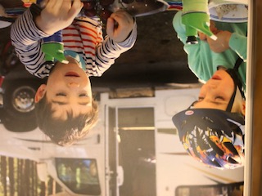
Timeline continued
2013 First
time playing
basketball
2012 First
time camping
In RV
2014 Trip to Hawaii

Slide 4
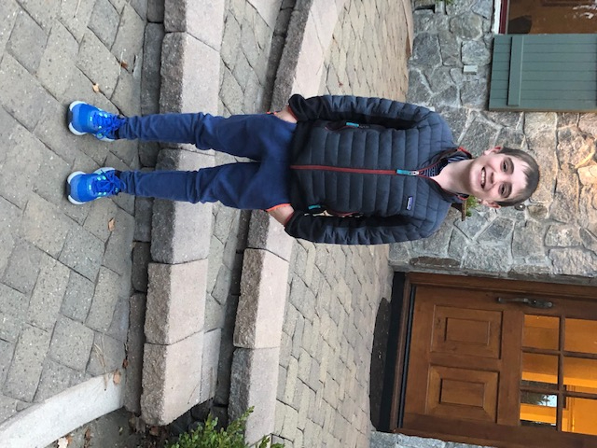
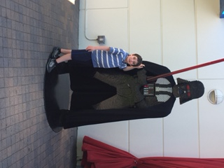
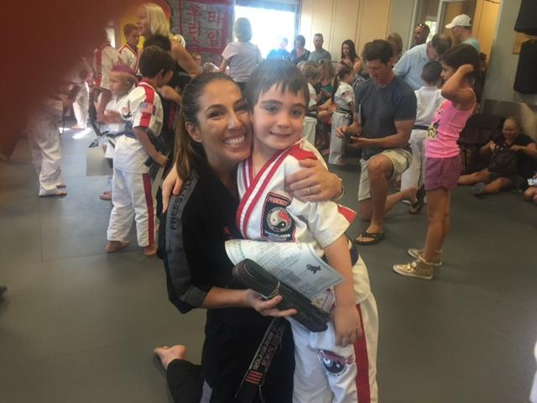
Timeline continued
2017 Trip to
Legoland
2015 Started taking karate
lessons
2016 Moved to
a new house

Slide 5
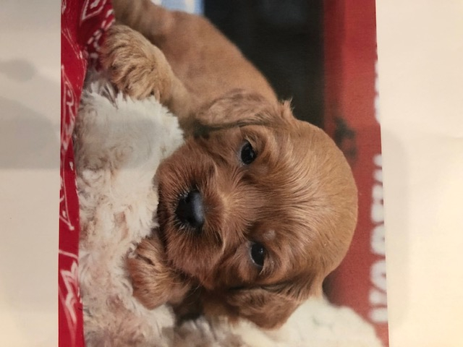
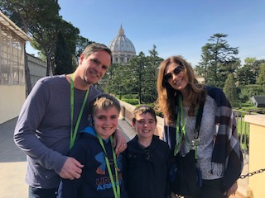
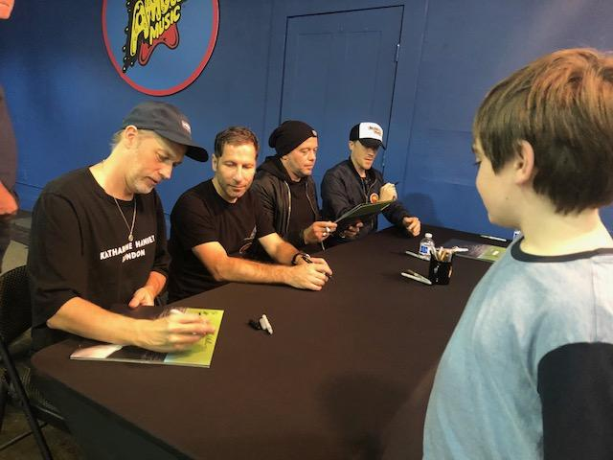
Timeline continued
2019 Met my
namesake
2020 Got my first
cute puppy
2018 Trip
to Italy

Slide 6
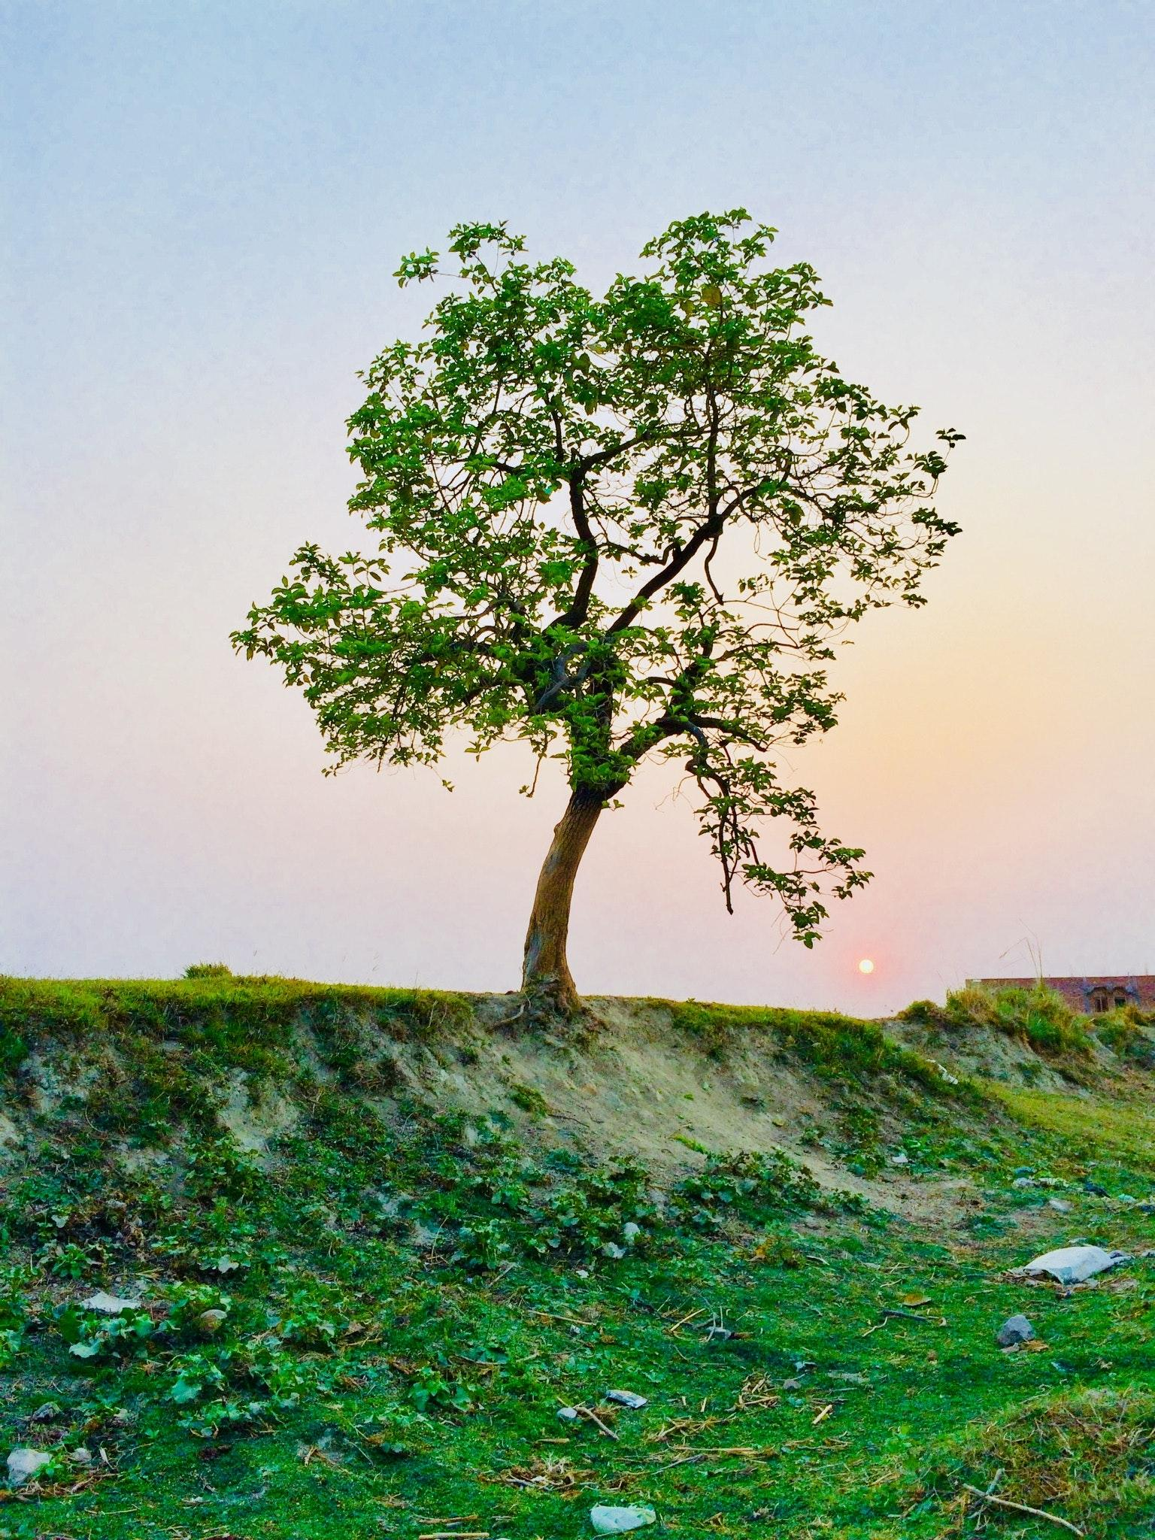
Family Tree
Ernest Mckenzie
B - June 21, 1918
D - Feb 12, 2002
BP - Moose Jaw Canada
Genevieve Gardella
B - May 21, 1918
D - Jan 25, 2020
BP - Wadsworth Nevada
Donald Bates
B - Sept 6, 1912
D - May 4, 1970
Geraldine Ryan
B - April 11, 1918
D - July 26, 1995
BP - Salt Lake City
William Edward Kindred
B - March 4, 1906
D - 1974
BP - New Madrid mo
Frances Lucille Stacy
B - 1907 Sikeston, MO.
D - 1983 Moline, IL.
Clarence Chambers
B - 1916
D - Sept 25, 1965
BP - Blue Grass Illinois
Doris Virginia Jensen
B - April 4, 1920
D - December 22, 2014
BP - Alton Iowa
Dale Ernest McKenzie
B- Sept. 1, 1943
Reno NV Alive
Victoria Bates
B- Feb. 25, 1945 Covington, KY
D- Feb. 25, 2006
James Carroll Kindred
B- July 6, 1930 Sikeston, MO.
D- Oct. 14, 2004
Wanda Virginia Chambers
B- Feb. 16, 1937 Davenport, IA
D- Oct. 17, 2004
Todd Ernest McKenzie B- Aug. 3, 1971 Reno, NV Alive
Cynthia Suzan McKenzie B- December 18. 1965 Moline IL. Alive
Loz Alexander McKenzie B- July 9, 2009 Reno NV. Alive

Slide 7
Heirloom Story
The 20 dollar bill came from The Ely National Bank, which was owned by my great great grandfather O.G. Bates. The money was used in 1929 by the people who had the 20 dollar bills. It is special to my family because it was signed by my great great grandfather O.G Bates. This is why it is a part of our family history. There is a cultural significance because we use money everyday in our lives to buy food or stuff. Also, it is almost a hundred years old. That is our Heirloom story.

Slide 8
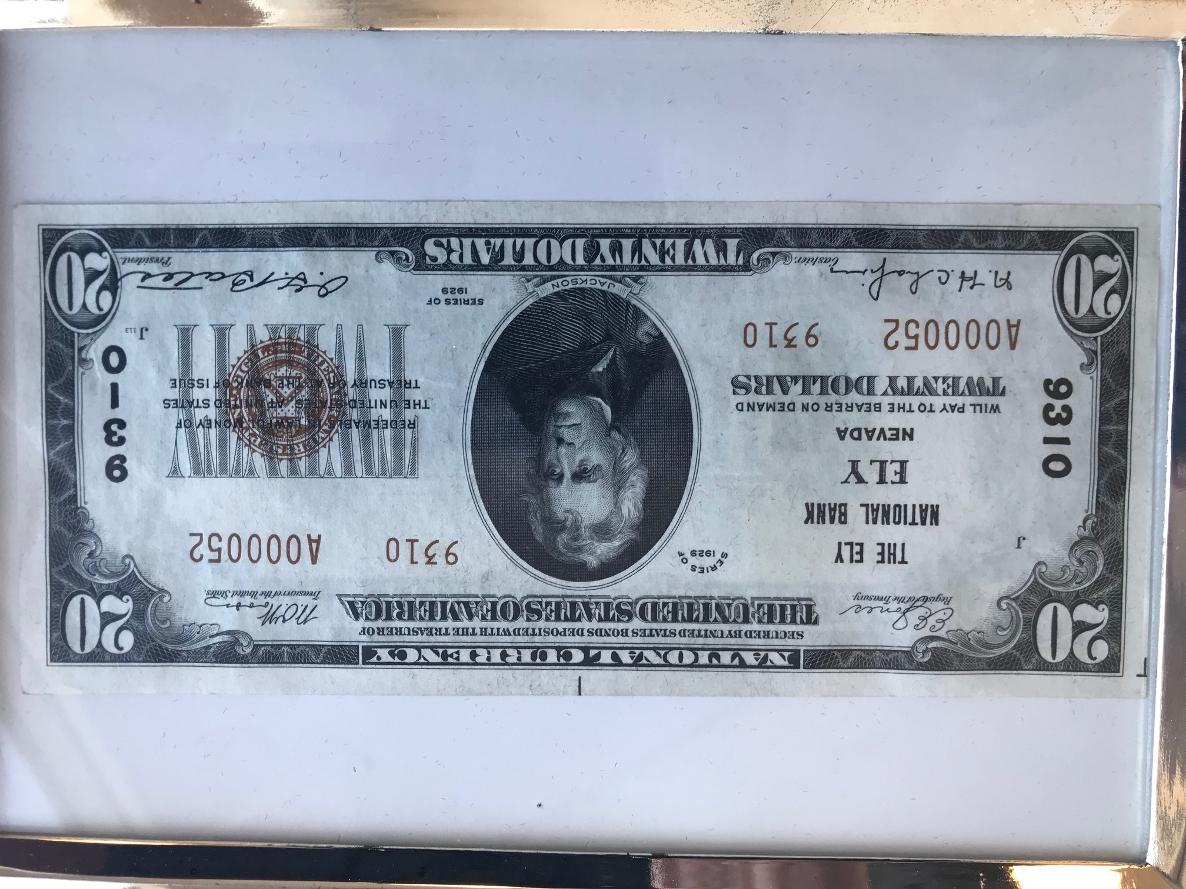
Heirloom story continued

Slide 9
Ole’s Swedish Hotcakes ingredients to bake
Ole’s Swedish Hotcakes
1 cup of flour
1 teaspoon of sugar
¼ teaspoon of salt
1 teaspoon of baking powder
Mix the above ingredients together.
1 ½ cup of milk and 1 ½ cup half and half.
Combine with the above ingredients.

Slide 10
Ole’s Swedish Hotcakes ingredients to bake continued
3 eggs
Separate whites from yokes and beat whites until stiff.
Beat yolks. Add yolks to batter. Then fold in whites of eggs.
Add ¾ cube of melted butter.

Slide 11
Ole’s Swedish Hotcakes
In our family we serve this recipe on Christmas morning. Four years ago we had Ole’s Swedish Hotcakes at my grandpa's house. They tasted delicious and everyone wanted seconds on Christmas morning. My grandpa made these Swedish Hotcakes on a special stove at his house. We had these cakes before we opened our presents on Christmas morning. We were so excited to have these cakes with my family members. My family members that were there were my auntie Kira, my auntie Shannon, dad, mom, brother, grandpa, grammie, and my grandma. My aunty Kira has a dog and a cat along with two little girls. She also has a boyfriend. My aunty Shannon used to live in Washington D.C, but now she lives in Macedonia. I enjoyed my grandparents' two dogs that were still alive at that time. On that Christmas morning, I remember them fake fighting with each other while they were biting and tackling. When I tasted the Swedish Hotcakes it became my favorite cake. The texture was chewy and thin which made the cakes taste great. Sometimes we have whipped cream on them and that makes them even better.

Slide 12
Biography
My biography report is on my grandfather, Dale Ernest Mckenzie. He was named Dale Ernest Mckenzie because his parents liked that name. His middle name was Ernest because that was his father’s first name. His father had no siblings. His wife had had six siblings May, Eleanor, Betty, Theresa, Louie, and Tess. He was born on September 1, 1943.
The advancement of technology changed his life by making things easier. It also made his work easier. Computers made things easier for bookkeeping was easier, keeping track of construction jobs, and he could do more work with less people. The new construction method made it easier, faster, and cheaper to build example the concrete tilt up method of building warehouses. When he was a child things were easier and more simple. Today politics are more complicated with the oligarchs who control the media, policies, and the way business is conducted . Business deals were made with a handshake. Now it is all done with lawyers.
He wanted to work in the family business, which was real estate development because his father started a good business. The family business is construction and investments in commercial properties. He was also expected to carry on the family business. His first job was sweeping floors at his family's company when he was 11 years old.

Slide 13
Biography Continued
During High school he worked as a surveyor for the power company where he learned a lot. He also worked at a plumbing supply house called Record Supply where he unloaded boxcars. Developing real estate was all that he wanted to do. He saw his father’s success and decided that he wanted to do that also.
The most beautiful place that he has ever visited is the South Island of New Zealand. He went there when he was in his 40’s and he traveled around on a motorcycle. The longest trip that he has ever taken was to Ireland, and France , and he was there for three weeks. His favorite vacation was to Ireland. It was because he was socialized with a group of people. One of the people in his group was the drummer of the band Bon Jovi. Everywhere they went they received the best treatment because everyone recognized him.

Slide 14
Biography continued
Dale’s favorite food is ravioli made by him or his mother. Dale’s first pet was a black Labrador named Jet. His favorite pet that he has ever owned was a very protective Rhodesian Ridgeback named Bosco.

Slide 15


